Slide 1
Onset Detection with Artificial Neural Networks for MIREX 2005
Alexandre Lacoste and Douglas Eck
EURASIP Journal on Advances in Signal Processing, Vol. 2007, Article ID 43745, 13 pages
Presenter: Mao-Yuan Kao
Date: Jan. 26, 2007

Slide 2
Abstract
We describe two onset detection algorithms that have
participated to the Mirex 2005 onset detection contest.
The proposed algorithms, first classify frames of a spectrogram into
onset or non-onset, using a feed forward neural network.
From the classification of each frames, it extract the onset times, using
a simple peak picking algorithm, based on a moving average.
Source Paper:
A Supervised Classification Algorithm for Note Onset Detection

Slide 3
What can we do with a good note onset detector ?
Not directly useful, but it is present in many music
algorithms.
Music transcription (from wave to midi)
Music editing (Song segmentation)
Tempo tracking (with onset, finding the tempos is much easier)
Musical fingerprinting (the onset trace can serve as a robust id for fingerprinting)

Slide 4
The algorithm can be split in 3 main steps
Get the spectrogram of the song
Convolve a feed-forward neural network across the spectrogram
Find the onset location

Slide 5
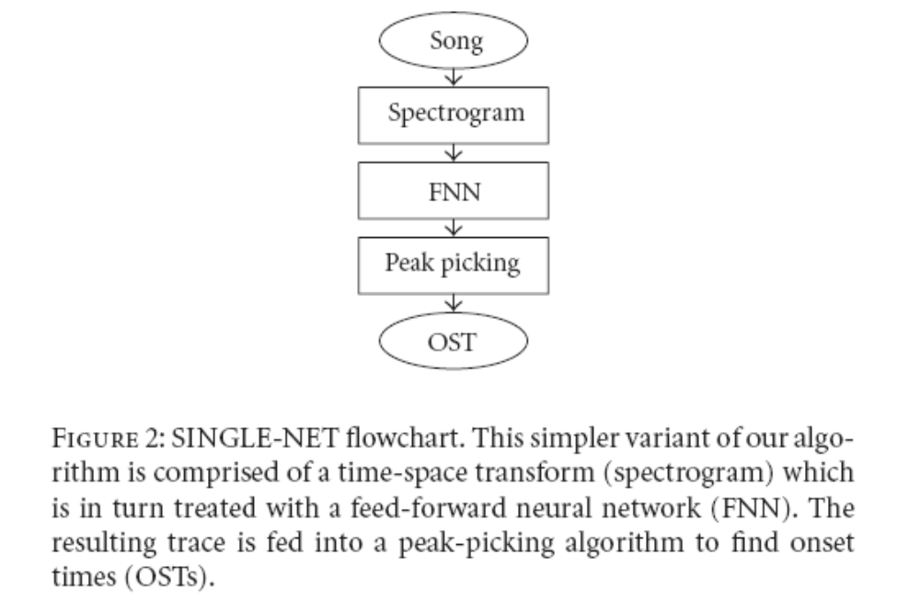
Single-Net

Slide 6
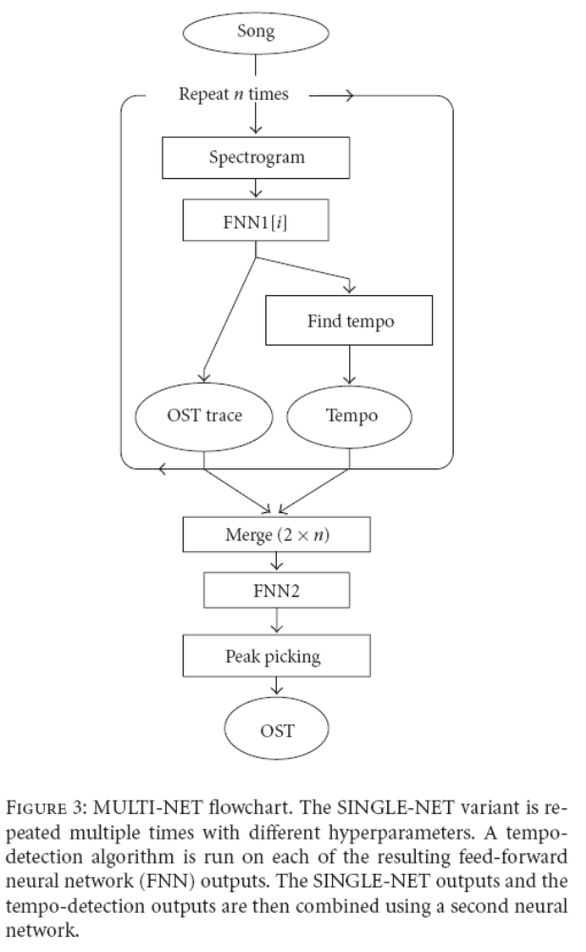
Multi-Net
combines information from
(A) multiple instantiations of SINGLE-NET,
each trained with different hyperparameters and
(B) tempo traces gained by running a tempo
detection algorithm on the neural network
output vector.
The multiple sources of evidence are merged into a feature matrix similar to a spectrogram
which is in turn fed back into another
feed-forward network, peak picker, and onset detector

Slide 7
Spectrograms
Many different time-frequency representation might be useful for this task.
Short-time Fourier transform (STFT)
Constant-Q transform
Phase plane of STFT

Slide 8
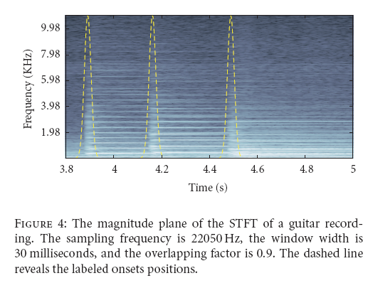
Short-time Fourier Transform
The yellow curve represents the onset time

Slide 9
Constant-Q Transform
The constant-Q transform is similar to the STFT but it has two main differences:
  it has a logarithmic frequency scale
  it has a variable window width
The constant-Q transform has a logarithmic frequency scale which provides:
  a much better frequency resolution for lower frequency.
  a better time resolution for high frequency.

Slide 10
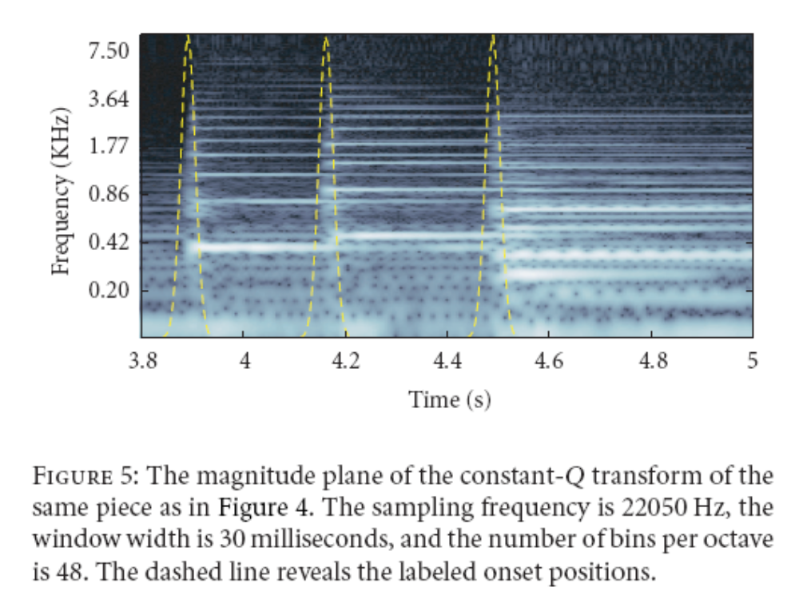
Constant-Q Transform (cont.)

Slide 11
Phase planes
Both STFT and constant-Q are complex transforms.
Therefore, we can separate their outputs into phase and magnitude planes.
Obviously, the magnitude planes contain relevant information,
see Figures 4 and 5.

Slide 12
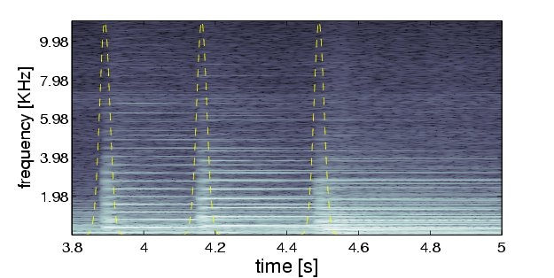
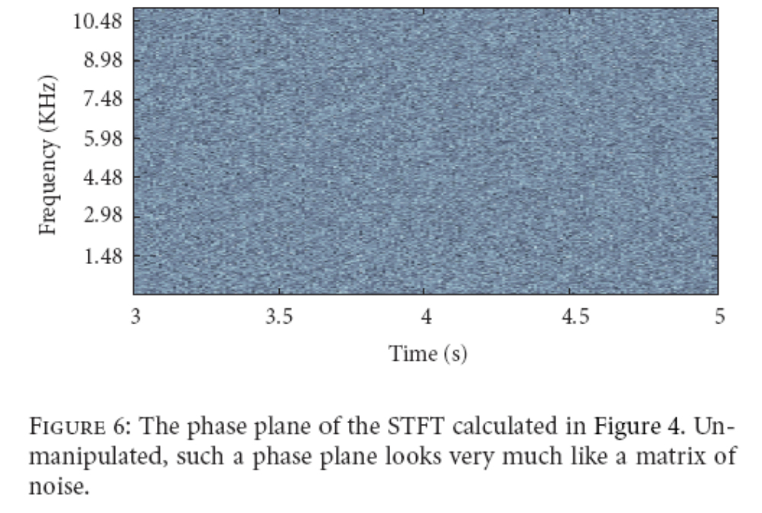
Can we do something with the phase plane ?
The phase plane, without any manipulation, doesn’t seems to contain any
information. (noisy)

Slide 13
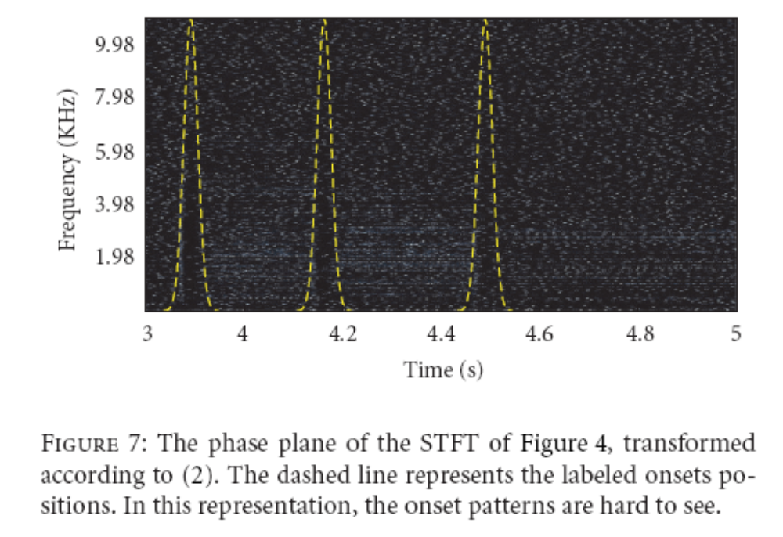
Phase Acceleration
Bello and Sandler [8] have found a way to use phase information for onset detection.
Patterns not evident enough !

Slide 14
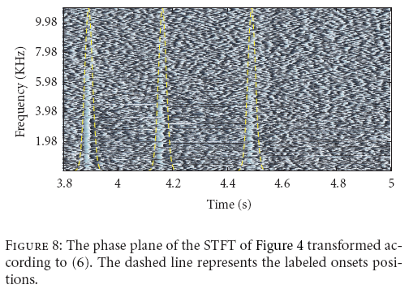
Phase frequency difference
Instead, if we simply take the difference along the frequency axis, we get interesting patterns.
Results show performance equivalent to the magnitude plane, using only the phase.

Slide 15
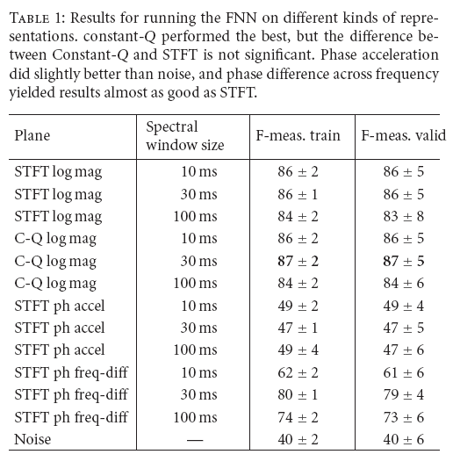

Slide 16
Feed Forward Neural Network
We employ a feed-forward neural network (FNN) to combine evidence from the
different transforms in order to classify the frames.
Our goal is to use the neural net as a filtering step in order to provide the best
possible trace for the peak-picking part.
The network predicts the class membership (onset or nononset) of each frame
in a sequence.
In this section, we use the term “window” to refer to the size of the input window
defining which feature frames are fed into the FNN.

Slide 17
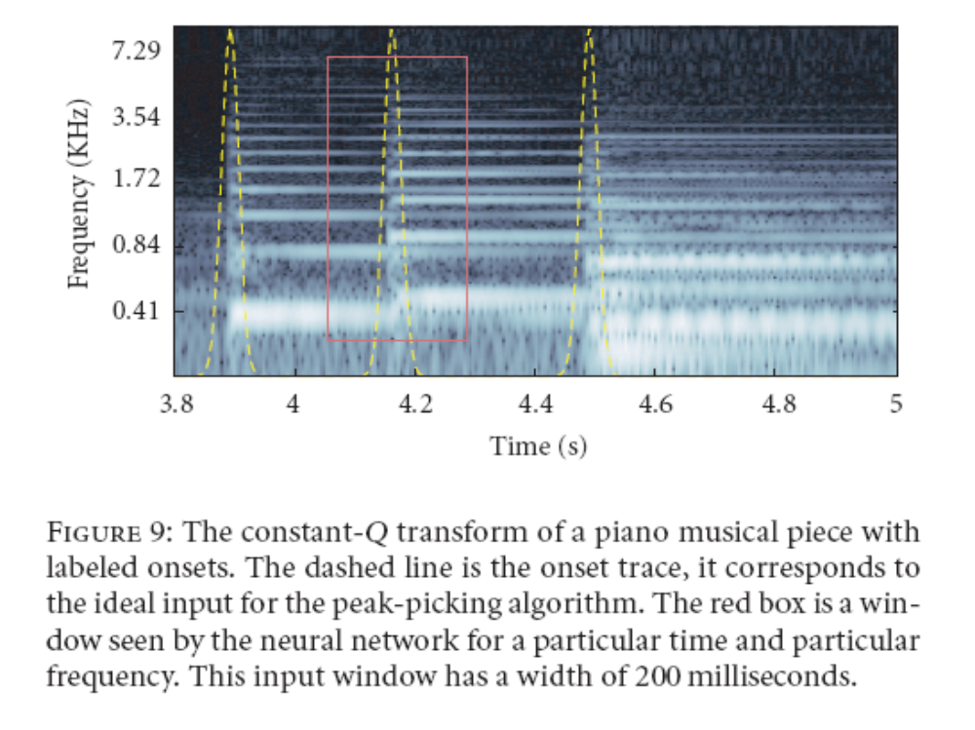

Slide 18
Net Inputs
For a decent spectrogram resolution
  Time : 200 bins / s
  Frequency : 200 bins
And a window width of 50 ms
We have 2000 input variables
This is too many !!!
We randomly sample 200 variables inside the window.
  Uniform distribution across frequency
  Gaussian distribution across time (more variables near the center)

Slide 19
Net Structure and Training
Two hidden layers
  18 units in the first layer
  15 units in the second layer
  1 output neuron
Learning algorithm : Polak-Ribiere version of conjugate gradient

Slide 20
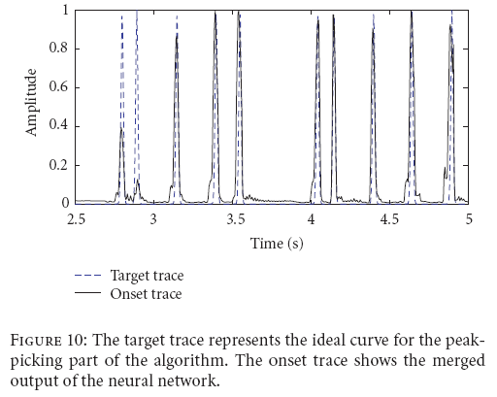
Net Output
Most peaks are really sharp and there is very low background noise.
Some peaks are smaller but still can be detected
The precision is also very good.

Slide 21
Peak-Picking
The neural networks only emphasize the onsets.
We now have to find the location of each onset.
We simply apply a threshold.
  positive crossing is the beginning
  Negative crossing is the end
  Location is the center of mass
The value of the threshold is learned by exhaustive search.
beginning
end

Slide 22
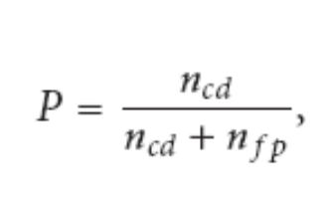


F-measure
To maximize the performance, we want to find the
maximum number of onsets (Recall)
But we also want to minimize the number of spurious
onsets (Precision)
F-measure is optimal when the number of false positives
equals the number of false negatives.
where n_{cd} is the number of correctly detected onsets, n_{fn}
is the number of false negatives, and n_{fp} is the number of
false positives.

Slide 23
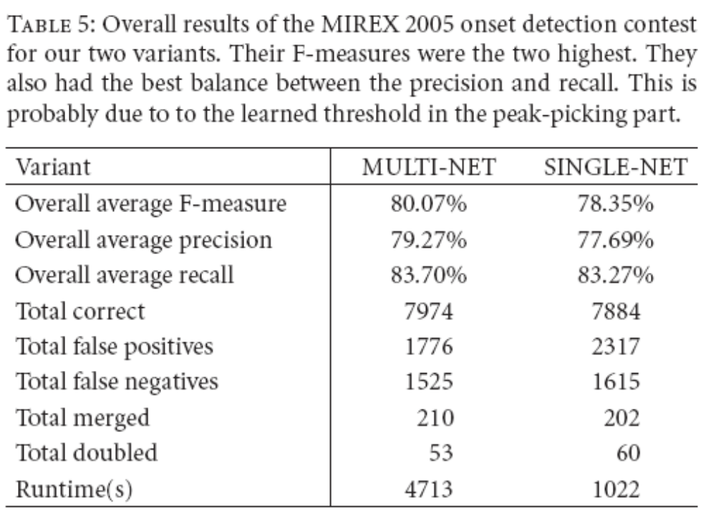
MIREX 2005 Results

Slide 24
Conclusion
Applying machine learning for the onset detection problem is simple and very efficient.
This provides an algorithm that is accurate and robust to a wide variety of songs.
It is not sensitive to hyper-parameter adjustment.

